Slide 1
DataBases
DataBase Design
Normalization Process

Slide 2
Objectives
Which database structures are considered Normal?
Difference between snapshot and temporal databases
Store Binary Large OBjects in databases

Slide 3
SQL Power Architect
Data Modeling

Slide 4
SQL Power Architect – Data Modeling
http://www.sqlpower.ca/page/architect
free database tool to design data models; forward/reverse engineer to/from any database platform; works with any database using generic framework; runs on every platform: PC, Mac, Unix

Slide 5
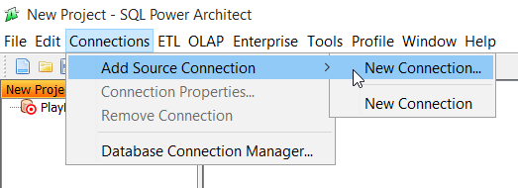
SQL Power Architect – Data Modeling

Slide 6
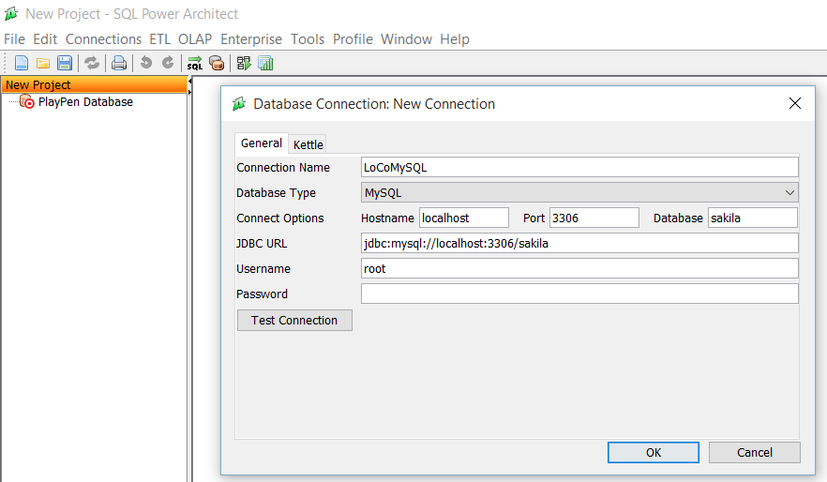
SQL Power Architect – Data Modeling

Slide 7
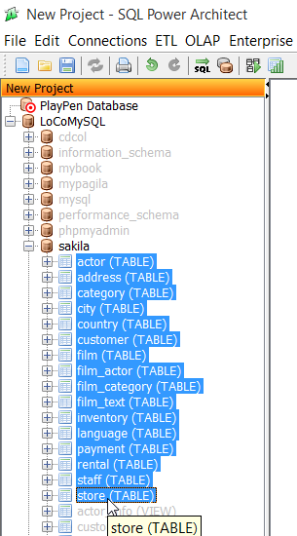
Reverse Engineering

Slide 8
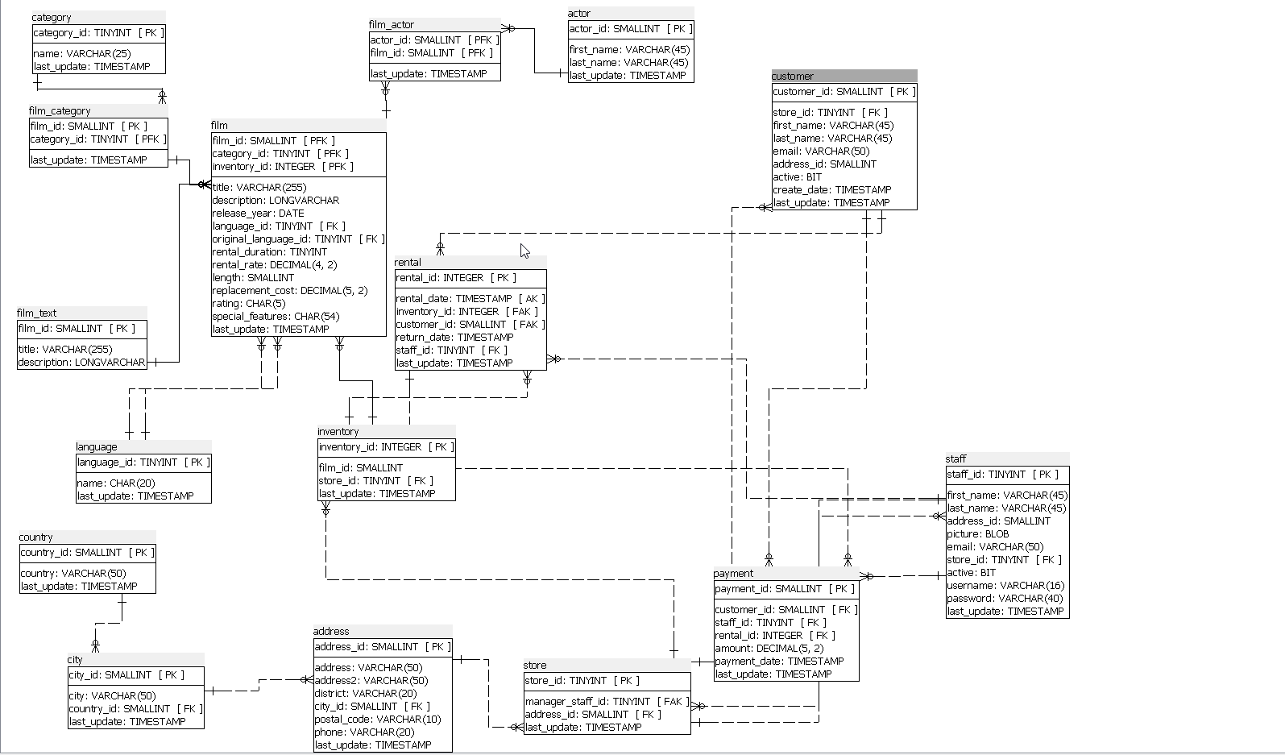
Sample database
Entity Relationship diagram

Slide 9
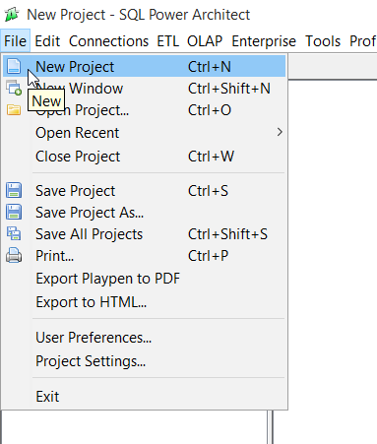
Forward Engineering
Create Entity – Relationship diagram

Slide 10
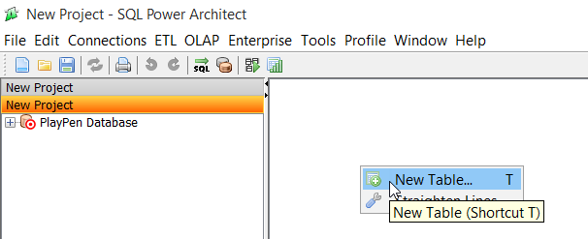

Slide 11
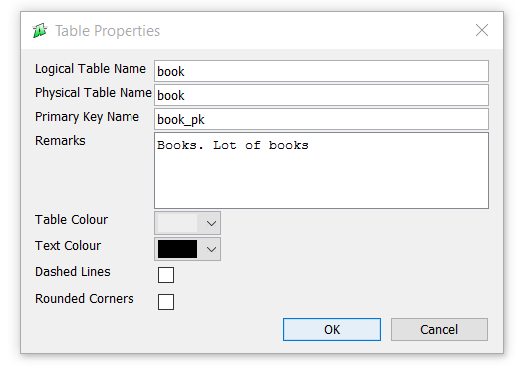

Slide 12
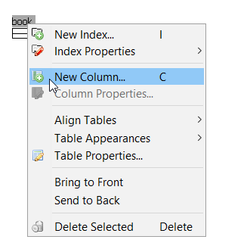

Slide 13
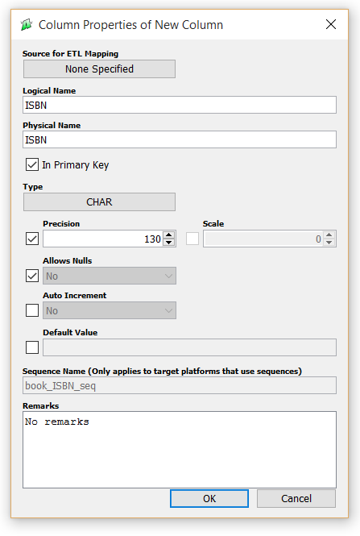

Slide 14
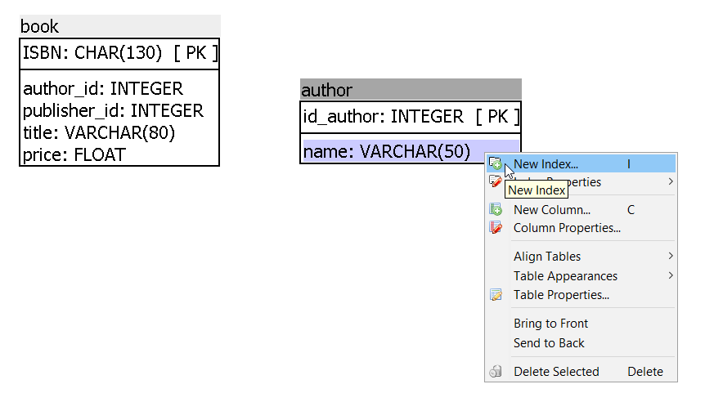

Slide 15
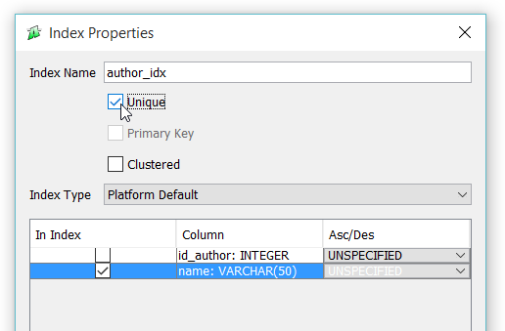

Slide 16


Slide 17
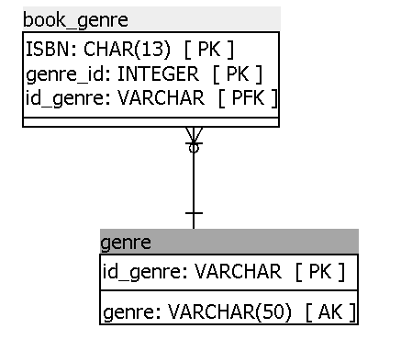

Slide 18
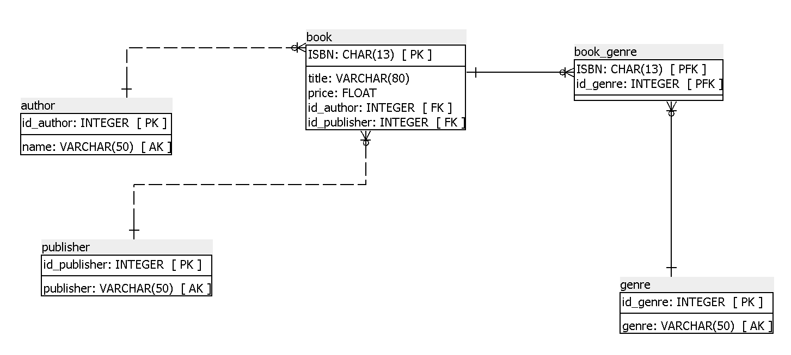

Slide 19
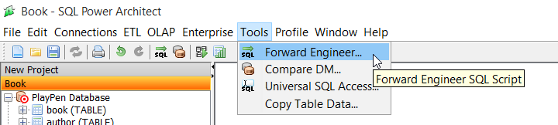
Forward Engineering

Slide 20
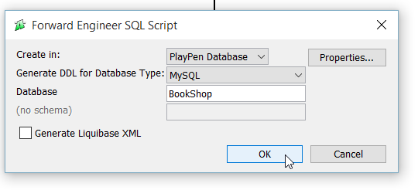
Forward Engineering

Slide 21
Forward Engineering
Save SQL file
Start DataBase Engine
  MySQL / Microsoft SQL Server
Start Front-End tool
  MySQL WorkBench / Management Studio
CREATE SCHEMA / DATABASE
Run SQL file

Slide 22
Generic SQL 92 standard
Oracle
PostgreSQL
Microsoft SQL Server
MySQL
IBM DB2
HSQLDB

Slide 23
DataBases
DataBase Design
Normalization Process

Slide 24
“Data modeling is not optional”
no database or system was ever built without at least an implicit model

Slide 25
software programs are designed to implement a process model (or functional specification)
  specifying business processes that the system is to perform
same way, database is specified by data model, describing what sort of data will be held and how it will be organized

Slide 26
Design – Choice & Creativity
in design, we do not expect to find a single correct answer, although we will certainly be able to identify many that are incorrect
2 data modelers given same set of requirements may produce quite different solutions

Slide 27
First choice of what symbols or codes we use to represent real-world facts in database
person’s age could be represented by Birth Date, Age at Date of …, or even by code corresponding to range

Slide 28
Second choice there is usually more than one way to organize (classify) data
  into tables and columns in relational model

Slide 29
Third choice requirements from which we work in practice are usually incomplete, or at least loose enough to accommodate a variety of different solutions

Slide 30
Fourth choice we have some options as to which part of system will handle each business requirement

Slide 31
Finally, and perhaps most importantly
  new information systems seldom deliver value simply by automating current way of doing things
to exploit information technology fully, we generally need to change our business processes and data required to support them
data modeler becomes a player in helping to design new way of doing business, rather than merely reflecting the old

Slide 32
We want you to learn not only to produce sound, workable models (that will not fall down) but to be able to develop and compare different options
not throw away rule book, not suggest that anything goes

Slide 33
Data Model Important
Leverage
Conciseness
Data Quality

Slide 34
Leverage
small change to data model may have major impact on system as whole
programs are far more complex and take longer to specify and construct than database
  their content and structure are heavily influenced by database design

Slide 35
Leverage
well-designed data model can make programming simpler and cheaper
poor data organization can be expensive to fix

Slide 36
Conciseness
data model is powerful tool for expressing information systems requirements and capabilities
implicitly defines whole set of screens, reports, and processes needed to capture, update, retrieve, and delete specified data

Slide 37
Data Quality
database is usually valuable business asset built up over long period
establishing common understanding of what is to be held in each table and column, and how it is to be interpreted
problems with data quality can be traced to lack of consistency
  in defining and interpreting data
  implementing mechanisms to enforce definitions

Slide 38
What Makes a Good Data Model?
Completeness
Non-redundancy
Enforcement of Business Rules
Data Reusability
Stability and Flexibility
Elegance
Communication
Integration
Conflicting Objectives
Performance

Slide 39
Completeness
Does the model support all the necessary data?

Slide 40
Non-redundancy
Does the model specify a database in which the same fact could be recorded more than once?

Slide 41
Enforcement of Business Rules
How accurately does the model reflect and enforce the rules that apply to the business’ data?

Slide 42
Data Reusability
Will data stored in database be re-useable for purposes beyond those anticipated in process model?
once an organization has captured data to serve particular requirement, other potential uses and users almost invariably emerge

Slide 43
Stability and Flexibility
How well will the model cope with possible changes to business requirements?
can any new data required to support such changes be accommodated in existing tables?
  or will we be forced to make major structural changes, with corresponding impact on the rest of the system?

Slide 44
Stability and Flexibility
data model is stable in the face of a change to requirements if we do not need to modify it at all
  we can talk of models being more or less stable, depending on level of change required
data model is flexible if it can be readily extended to accommodate likely new requirements with only minimal impact on existing structure

Slide 45
Elegance
Does the data model provide a reasonably neat and simple classification of the data?
simple
consistent
easily described and summarized

Slide 46
Communication
How effective is the model in supporting communication among various stakeholders in the design of a system?
Do tables and columns represent business concepts that users and business specialists are familiar with and can easily verify?
Will programmers interpret model correctly?

Slide 47
Integration
How will the proposed database fit with organization’s existing and future databases?
  common for the same data to appear in more than one database and for problems to arise
How easy is it to keep different versions in step, or to assemble a complete picture?

Slide 48
Conflicting Objectives
above aims will conflict with one another
elegant but radical solution may be difficult to communicate to conservative users
can be attracted to elegant model that we exclude requirements that do not fit
model that accurately enforces large number of business rules will be unstable if some rules change
model that is easy to understand because (reflects perspectives of immediate system users) may not support reusability or integrate well with other

Slide 49
Performance
system user will not be satisfied if our complete, non-redundant, flexible, and elegant database cannot meet throughput and response-time requirements
differs from our other criteria because it depends heavily on software and hardware platforms on which database will run
  exploiting their capabilities is technical task
  quite different from more business-focused modeling

Slide 50
Performance
performance requirements are usually “added to the mix” at a later stage than other criteria, and then only when necessary
usual (and recommended) procedure is to develop data model without considering performance
attempt to implement it with available hardware and software
if it is not possible to achieve adequate performance in this way do we consider modifying the model itself

Slide 51
Objectives
Describe data normalization process
Perform data normalization process
Test tables for irregularities using data normalization process

Slide 52
Database Design
Conceptual Data Modeling
Normalization Process
Implementing Base Table Structures

Slide 53
Normalization Process

Slide 54
Normalization
process of taking entities and attributes that have been discovered and making them suitable for the relational database
process does this by removing redundancies and shaping data in manner that the relational engine desires

Slide 55
Normalization
based on a set of levels, each of which achieves level of correctness or adherence to a particular set of rules
rules formally known as forms, normal forms
First Normal Form(1NF)
  which eliminates data redundancy
and continue through to
Fifth Normal Form (5NF)
  which deals with decomposition of ternary relationships

Slide 56
Normalization
each level of normalization indicates an increasing degree of adherence to the recognized standards of database design
as you increase degree of normalization of your data, you’ll naturally tend to create an increasing number of tables of decreasing width (fewer columns)

Slide 57
Why Normalize?
eliminate data that’s duplicated, chance it won’t match when you need it
avoid unnecessary coding needed to keep duplicated data in sync
keep tables thin, increase number of values that will fit on a page (8K) – decrease number of reads that will be needed
maximizing use of clustered indexes – allow for more optimum data access and joins
lowering number of indexes per table - indexes are costly to maintain

Slide 58
Eliminating duplicated data
any piece of data that occurs more than once in database is an error waiting to happen

Slide 59
Process of Normalization
take entities that are complex and extract simpler entities from them
continues until every table in database represents one thing and every column describes that thing

Slide 60
3 categories of normalization steps
entity and attribute shape
relationships between attributes
multi-valued and join dependencies in entities

Slide 61
Entity and attribute shape
First Normal Form
all attributes must be atomic, that is, only a single value represented in a single attribute in a single instance of an entity
all instances of an entity must contain the same number of values
all instances of an entity must be different

Slide 62
First Normal Form
violations often manifest themselves in implemented model with data handling being far less optimal, usually because of having to decode multiple values stored where a single one should be or because of having duplicated rows that cannot be distinguished from one another

Slide 63
for example, consider group of data like 1, 2, 3, 5, 7
likely represents five separate values
atomicity is to consider whether you would ever need to deal with part of column without other parts of data in that same column
1, 2, 3, 5, 7 list always treated as single value, it might be acceptable to store value in single column
if you might need to deal with value 3 individually, then the list is definitely not in First Normal Form
if there is not plan to use list elements individually, you should consider whether it is still better to store each value individually to allow for future possible usage

Slide 64
E-Mail Addresses
name1@domain1.com
AccountName: name1
Domain: domain1.com

Slide 65
E-Mail Addresses
intend to access individual parts
all you’ll ever do is send e-mail, then single column is perfectly acceptable
need to consider what domains you have e-mail addresses stored for, then it’s a completely different matter

Slide 66
Telephone Numbers
AAA-EEE-NNNN (XXXX):
AAA area code – indicates calling area located within a state
EEE exchange - indicates a set of numbers within an area code
NNNN number - used to make individual phone numbers unique
XXXX extension - number that must be dialed after connecting

Slide 67
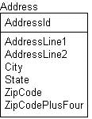
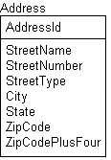
Mailing Addresses

Slide 68
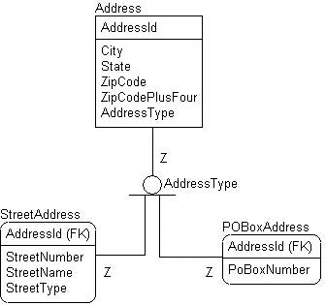
Mailing Addresses

Slide 69
All instances in entity contain same number of values
entities have a fixed number of attributes
  and tables have a fixed number of columns
entities should be designed such that every attribute has a fixed number of values associated with it
example of a violation of this rule in entities that have several attributes with same base name suffixed (or prefixed) with a number, such as Payment1, Payment2, and so on,

Slide 70
Programming Anomalies avoided by First Normal Form
modifying lists in single column
modifying multipart values
dealing with a variable number of facts in an instance

Slide 71
Clues that design is not in First Normal Form
string data that contains separator-type characters
attribute names with numbers at the end
tables with no or poorly defined keys

Slide 72
Relationships Between Attributes
Second Normal Form
  relationships between non-key attributes and part of the primary key
Third Normal Form
  relationships between non-key attributes
BCNF (Boyce Codd Normal Form)
  relationships between non-key attributes and any key
Non-key attributes must provide a detail about the key, the whole key, and nothing but the key.

Slide 73
Second Normal Form
entity must be in First Normal Form.
each attribute must be a fact describing the entire key
technically relevant only when a composite key (a key composed of two or more columns) exists in the entity

Slide 74
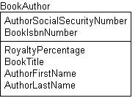
Each non-key attribute must describe entire key

Slide 75
BookIsbnNumber attribute uniquely identifies book
AuthorSocialSecurityNumber uniquely identifies author
two columns create key that uniquely identifies an author for book
BookTitle describes book
  but doesn’t describe author at all
AuthorFirstName and AuthorLastName, describe author
  but not book

Slide 76
BookIsbnNumber → BookTitle
AuthorSocialSecurityNumber → AuthorFirstName
AuthorSocialSecurityNumber → AuthorLastName
BookIsbnNumber, AuthorSocialSecurityNumber → RoyaltyPercentage

Slide 77
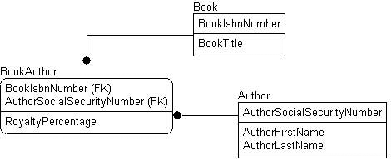

Slide 78
Programming problems avoided
all programming issues that arise with Second Normal Form (as well as Third and Boyce-Codd Normal Forms) deal with functional dependencies that can end up corrupting data

Slide 79
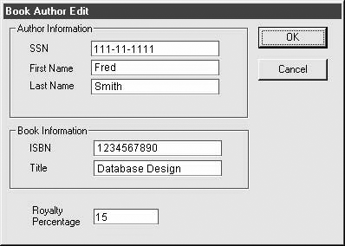

Slide 80
same author’s information would have to be duplicated amongst all books
cannot delete only book and keep author around
cannot insert only author whitout book

Slide 81
Annomalies
UPDATE
  duplicate date, have to update multiple rows
INSERT
  cannot insert data for an entity whitout relationship to any other entity
DELETE
  cannot delete data for an entity whitout risk of looseing info. about related entity

Slide 82
Clues that entity is not in Second Normal Form
repeating key attribute name prefixes, indicating that values are probably describing some additional entity
data in repeating groups, showing signs of functional dependencies between attributes
composite keys without foreign key, which might be sign you have key values that identify multiple things in key

Slide 83
Third Normal Form
entity must be in Second Normal Form.
non-key attributes cannot describe other non-key attributes

Slide 84
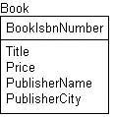
non-key attributes cannot describe other non-key attributes

Slide 85
Title defines title for the book defined by BookIsbnNumber
Price indicates price of the book
PublisherName describes the book’s publisher
PublisherCity also sort of describes something about the book, in that it tells where the publisher was located
doesn’t make sense in this context, because location of publisher is directly dependent on what publisher is represented by PublisherName

Slide 86
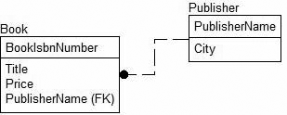

Slide 87
Publisher entity has data concerning only publisher
Book entity has book information
  now if we want to add information to our schema concerning the publisher, contact information or address, it’s obvious where we add that information
City attribute clearly identifying publisher
  not the book

Slide 88
Clues that entities are not in Third Normal Form
multiple attributes with same prefix
  much like Second Normal Form, only this time not in the key
repeating groups of data
summary data that refers to data in a different entity altogether
  Price in Invoice as SUM(Quantity*ProductCost) from LineItems

Slide 89
Boyce-Codd Normal Form
Ray Boyce, Edgar F. Codd
entity is in First Normal Form.
all attributes are fully dependent on a key
every determinant is a key

Slide 90
Entity in BCNF if every Determinant is key
Any attribute or combination of attributes on which any other attribute or combination of attributes is functionally dependent.
BCNF extends previous normal forms by saying that entity might have many keys, and all attributes must be dependent on one of these keys

Slide 91
Third Normal Form table which does not have multiple overlapping candidate keys is guaranteed to be in BCNF
Third Normal Form table with two or more overlapping candidate keys may or may not be in BCNF

Slide 92
Court Bookings
Court | Start Time | End Time | Rate Type
1 | 09:30 | 10:30 | SAVER
1 | 11:00 | 12:00 | SAVER
1 | 14:00 | 15:30 | STANDARD
2 | 10:00 | 11:30 | PREMIUM-B
2 | 11:30 | 13:30 | PREMIUM-B
2 | 15:00 | 16:30 | PREMIUM-A

Slide 93
Court Bookings
hard court (Court1) and grass court (Court2)
booking defined by Court and period for which the Court is reserved
booking has Rate Type associated
  SAVER for hard made by members
  STANDARD for hard made by non-members
  PREMIUM-A for grass made by members
  PREMIUM-B for grass made by non-members

Slide 94
Court Bookings - candidate keys
{Court, Start Time}
{Court, End Time}
{Rate Type, Start Time}
{Rate Type, End Time}

Slide 95
table adheres to both 2NF and 3NF
table does not adhere to BCNF
because of dependency Rate Type → Court, in which the determining attribute (Rate Type) is neither a candidate key nor a superset of a candidate key

Slide 96
Rate Types
Court Bookings
Rate Type | Court | Member Flag
SAVER | 1 | Yes
STANDARD | 1 | No
PREMIUM-A | 2 | Yes
PREMIUM-B | 2 | No
Court | Start Time | End Time | Member Flag
1 | 09:30 | 10:30 | Yes
1 | 11:00 | 12:00 | Yes
1 | 14:00 | 15:30 | No
2 | 10:00 | 11:30 | No
2 | 11:30 | 13:30 | No
2 | 15:00 | 16:30 | Yes

Slide 97
candidate keys for Rate Types table are {Rate Type} and {Court, Member Flag}
candidate keys for Court Bookings table are {Court, Start Time} and {Court, End Time}
both tables are in BCNF
having one Rate Type associated with two different Courts is now impossible
anomaly affecting original table has been eliminated

Slide 98
Multivalued Dependencies
Third Normal Form is generally considered pinnacle of proper database design
serious problems might still remain in logical design

Slide 99
Fourth Normal Form
entity must be in BCNF
there must not be more than one multivalued dependency between an attribute and the key of the entity

Slide 100
Fourth Normal Form
table is in 4NF if and only if, for every one of its non-trivial multivalued dependencies X →→ Y, X is a super key, X is either candidate key or superset thereof

Slide 101
Fourth Normal Form violations
ternary relationships
lurking multivalued attributes
temporal data/value history

Slide 102
Restaurant | Pizza Variety | Delivery Area
A1 Pizza | Thick Crust | Springfield
A1 Pizza | Thick Crust | Shelbyville
A1 Pizza | Thick Crust | Capital City
A1 Pizza | Stuffed Crust | Springfield
A1 Pizza | Stuffed Crust | Shelbyville
A1 Pizza | Stuffed Crust | Capital City
Elite Pizza | Thin Crust | Capital City
Elite Pizza | Stuffed Crust | Capital City
Vincenzo's Pizza | Thick Crust | Springfield
Vincenzo's Pizza | Thick Crust | Shelbyville
Vincenzo's Pizza | Thin Crust | Springfield
Vincenzo's Pizza | Thin Crust | Shelbyville

Slide 103
table has no non-key attributes
meets all normal forms up to BCNF
not in 4NF, non-trivial multivalued dependencies
{Restaurant} →→ {Pizza Variety}
{Restaurant} →→ {Delivery Area}
eliminate possibility of anomalies

Slide 104
Restaurant | Pizza Variety
A1 Pizza | Thick Crust
A1 Pizza | Stuffed Crust
Elite Pizza | Thin Crust
Elite Pizza | Stuffed Crust
Vincenzo's Pizza | Thick Crust
Vincenzo's Pizza | Thin Crust
Restaurant | Delivery Area
A1 Pizza | Springfield
A1 Pizza | Shelbyville
A1 Pizza | Capital City
Elite Pizza | Capital City
Vincenzo's Pizza | Springfield
Vincenzo's Pizza | Shelb

Slide 105
in contrast, if pizza varieties offered by restaurant sometimes did legitimately vary from one delivery area to another, the original three-column table would satisfy 4NF

Slide 106
Fifth Normal Form
not every ternary relationship can be broken down into two entities related to a third
aim of 5NF is to ensure that any ternary relationships that still exist in 4NF that can be decomposed into entities are decomposed
eliminates problems with update anomalies due to multivalued dependencies
  much like in 4NF only these are trickier to find.

Slide 107
Denormalization
used primarily to improve performance in cases where overnormalized structures are causing overhead to query processor
whether slightly slower (but 100 percent accurate) application is preferable to a faster application of lower accuracy
during logical modeling, we should never step back from our normalized structures to performance-tune our applications proactively

Slide 108
Key Terms
Data normalization
Database design / Data structures
Logical database design
Entity-relationship diagram conversion
Functional dependencies
Redundant data
1st Normal Form, 2nd NF, 3rd NF
Boyce – Codd Normal Form

Slide 109
Normalization of Database Tables
Another Example

Slide 110
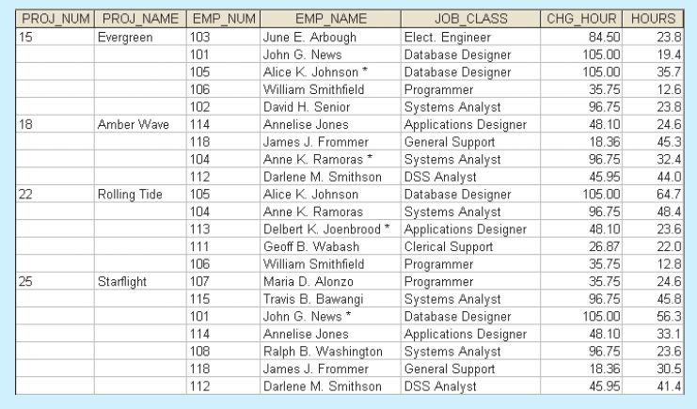
Report generated

Slide 111
an employee can be assigned to more than one project
each project includes only a single occurrence of any one employee

Slide 112
project number (PROJ_NUM) is apparently intended to be a primary key or at least a part of a PK, but it contains nulls
  PROJ_NUM + EMP_NUM will define each row
table entries invite data inconsistencies
  for example, JOB_CLASS value “Elect. Engineer” might be entered as “Elect.Eng.” in some cases, “El. Eng.” in others, and “EE” in still others

Slide 113
data redundancies yield the following anomalies:
Update anomalies
Insertion anomalies
Deletion anomalies

Slide 114
Update anomalies
Modifying the JOB_CLASS for employee number 105 requires (potentially) many alterations, one for each EMP_NUM = 105.

Slide 115
Insertion anomalies
Just to complete a row definition, a new employee must be assigned to a project
If the employee is not yet assigned, a phantom project must be created to complete the employee data entry

Slide 116
Deletion anomalies
Suppose that only one employee is associated with a given project
If that employee leaves the company and the employee data are deleted, the project information will also be deleted
To prevent the loss of the project information, a fictitious employee must be created just to save the project information

Slide 117
well-formed relations
objective of normalization is to ensure that each table conforms to the concept of well-formed relations, that is, tables that have the following characteristics:

Slide 118
Each table represents a single subject
  for example, course table will contain only data that directly pertain to courses
  similarly, student table will contain only student data
No data item will be unnecessarily stored in more than one table (tables have minimum controlled redundancy)
  the reason for this requirement is to ensure that the data are updated in only one place

Slide 119
All nonprime attributes in a table are dependent on the primary key, the entire primary key and nothing but the primary key
  reason for this requirement is to ensure that the data are uniquely identifiable by primary key value
each table is void of insertion, update, or deletion anomalies
  to ensure integrity and consistency of data

Slide 120
Functional dependence
attribute B is fully functionally dependent on attribute A if each value of A determines one and only one value of B
Example: PROJ_NUM → PROJ_NAME
  read as “PROJ_NUM functionally determines PROJ_NAME”
  attribute PROJ_NUM is known as “determinant” attribute, and attribute PROJ_NAME is known as “dependent” attribute

Slide 121
Functional dependence
Attribute A determines attribute B (that is, B is functionally dependent on A) if all of the rows in table that agree in value for attribute A also agree in value for attribute B

Slide 122
Step 1:
Eliminate the Repeating Groups
Start by presenting the data in a tabular format, where each cell has a single value and there are no repeating groups.
To eliminate the repeating groups, eliminate the nulls by making sure that each repeating group attribute contains an appropriate data value.

Slide 123
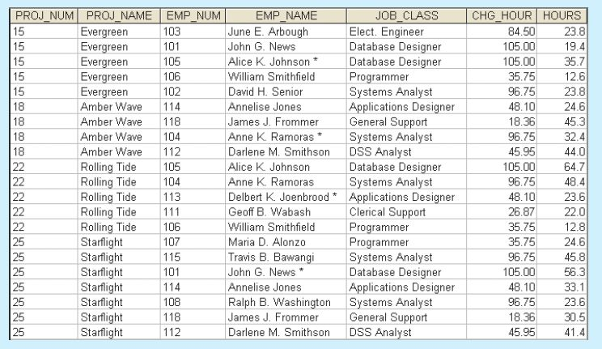
Table in first normal form 1NF

Slide 124
first normal form (1NF)
describes tabular format in which:
all of key attributes are defined
there are no repeating groups in the table
each row/column intersection contains only atomic values, one and only one value, not set of values
all attributes are dependent on primary key
all relational tables satisfy 1NF requirements

Slide 125
Step 2:
Identify the Primary Key
that will uniquely identify any attribute value must be composed of a combination of PROJ_NUM and EMP_NUM
identification of PK in Step 2 means that you have already identified following dependency:
PROJ_NUM, EMP_NUM → PROJ_NAME, EMP_NAME, JOB_CLASS, CHG_HOUR, HOURS

Slide 126
Step 3: Identify All Dependencies
PROJ_NUM → PROJ_NAME
EMP_NUM → EMP_NAME, JOB_CLASS, CHG_HOUR
JOB_CLASS → CHG_HOUR

Slide 127
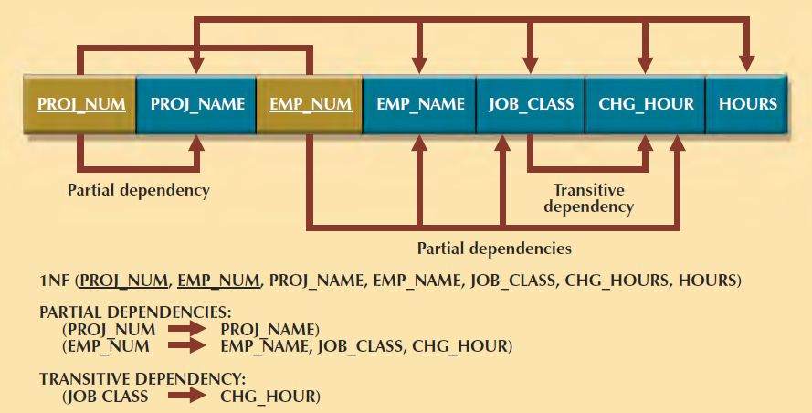
Dependency Diagram

Slide 128
Dependency Diagram
primary key attributes are bold, underlined, and shaded in different color.
arrows above attributes indicate all desirable dependencies, that is, dependencies that are based on PK; entity’s attributes are dependent on combination of PROJ_NUM and EMP_NUM
arrows below indicate less desirable dependencies; Two types of such dependencies exist:

Slide 129
Partial dependencies - you need to know only PROJ_NUM to determine the PROJ_NAME; that is, PROJ_NAME is dependent on only part of PK; and you need to know only EMP_NUM to find EMP_NAME, JOB_CLASS, and CHG_HOUR. Dependency based on only a part of a composite primary key is a partial dependency
Transitive dependencies - CHG_HOUR is dependent on JOB_CLASS; neither CHG_HOUR nor JOB_CLASS is prime attribute (at least part of key) condition is transitive dependency. Transitive dependency is a dependency of one nonprime attribute on another. Transitive dependencies still yield data anomalies

Slide 130
Data Redundancies … Anomalies
occur because row entry requires duplication of data
if Alice K. Johnson submits her work log, user would have to make multiple entries during course of a day
  for each entry, EMP_NAME, JOB_CLASS, and CHG_HOUR must be entered each time, even though attribute values are identical for each row entered
duplicate effort inefficient, helps create anomalies: nothing prevents from typing slightly different versions of employee name, position, hourly pay
data anomalies violate relational database’s integrity and consistency rules

Slide 131
Conversion to Second Normal Form
Converting to 2NF is done only when the 1NF has a composite primary key.
If the 1NF has a single-attribute primary key, then the table is automatically in 2NF.

Slide 132
Step 1: Make New Tables to Eliminate Partial Dependencies
for each component of primary key that acts as determinant in a partial dependency, create a new table with copy of that component as primary key
while these components are placed in new tables, it is important that they also remain in original table as well - they will be foreign keys for the relationships that are needed to relate these new tables to original table

Slide 133
PROJ_NUM
EMP_NUM
PROJ_NUM EMP_NUM
each component will become key in new table
original table is now divided into three tables (PROJECT, EMPLOYEE, and ASSIGNMENT)

Slide 134
Step 2: Reassign Corresponding Dependent Attributes
dependencies for original key components are found by examining arrows below dependency diagram
attributes that are dependent in a partial dependency are removed from original table and placed in new table with its determinant
any attributes that are not dependent in partial dependency will remain in original table

Slide 135
PROJECT (PROJ_NUM, PROJ_NAME)
EMPLOYEE (EMP_NUM, EMP_NAME, JOB_CLASS, CHG_HOUR)
ASSIGNMENT (PROJ_NUM, EMP_NUM, ASSIGN_HOURS)

Slide 136
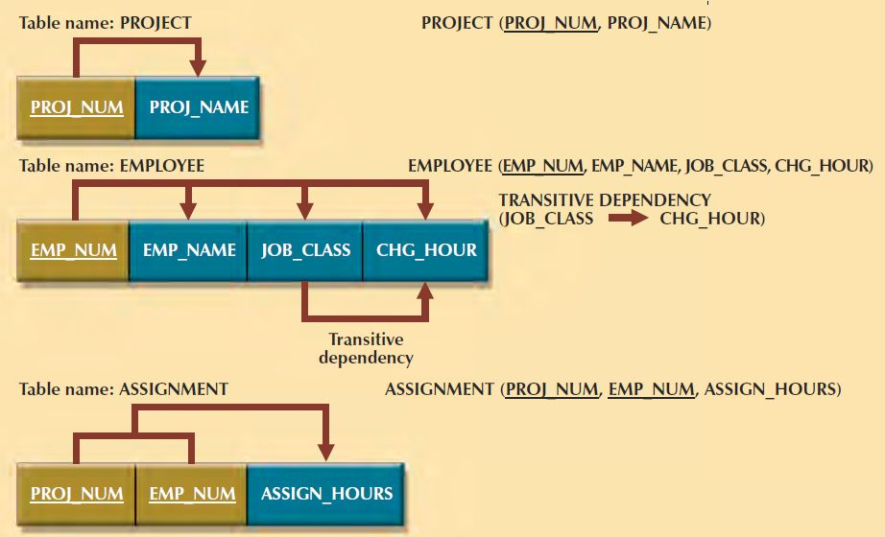
Second normal form (2NF)

Slide 137
second normal form (2NF)
table is in second normal form (2NF) when:
it is in 1NF
and
it includes no partial dependencies; that is, no attribute is dependent on only portion of primary key

Slide 138
Because number of hours spent on each project by each employee is dependent on both PROJ_NUM and EMP_NUM in ASSIGNMENT table, you leave those hours in ASSIGNMENT table
ASSIGNMENT table contains composite primary key composed of attributes PROJ_NUM and EMP_NUM
primary key/foreign key relationships have been created

Slide 139
most of the anomalies discussed earlier have been eliminated
for example, if you now want to add, change, or delete a PROJECT record, you need to go only to PROJECT table and make the change to only one row
transitive dependency can generate anomalies
for example, if charge per hour changes for job classification held by many employees, that change must be made for each of those employees
if you forget to update some of employee records that are affected by charge per hour change, different employees with same job description will generate different hourly charges

Slide 140
Conversion to Third Normal Form

Slide 141
Step 1: Make New Tables to Eliminate Transitive Dependencies
for every transitive dependency, write a copy of its determinant as primary key for new table
determinant is any attribute whose value determines other values within a row
if you have three different transitive dependencies, you will have three different determinants
determinant remain in original table to serve as foreign key

Slide 142
determinant for this transitive dependency as:
JOB_CLASS

Slide 143
Step 2: Reassign Corresponding Dependent Attributes
identify the attributes that are dependent on each determinant identified
place dependent attributes in new tables with their determinants and remove them from their original tables

Slide 144
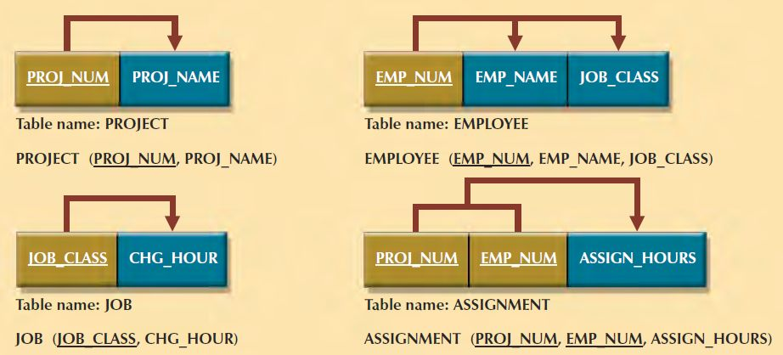
Third normal form (3NF)

Slide 145
third normal form (3NF)
table is in third normal form (3NF) when:
it is in 2NF
and
it contains no transitive dependencies

Slide 146
PROJECT (PROJ_NUM, PROJ_NAME)
EMPLOYEE (EMP_NUM, EMP_NAME, JOB_CLASS)
JOB (JOB_CLASS, CHG_HOUR)
ASSIGNMENT (PROJ_NUM, EMP_NUM, ASSIGN_HOURS)

Slide 147
technique is the same, …
it is imperative that 2NF be achieved before moving on to 3NF;
be certain to resolve partial dependencies before resolving transitive dependencies

Slide 148
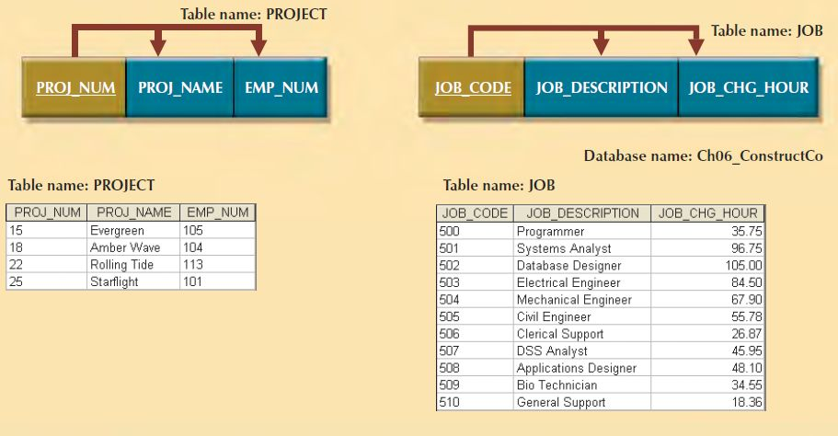
Improving Design

Slide 149
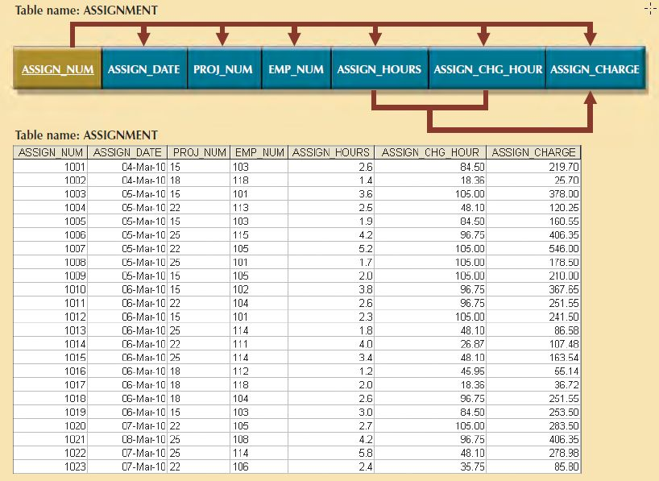
Completed Database

Slide 150
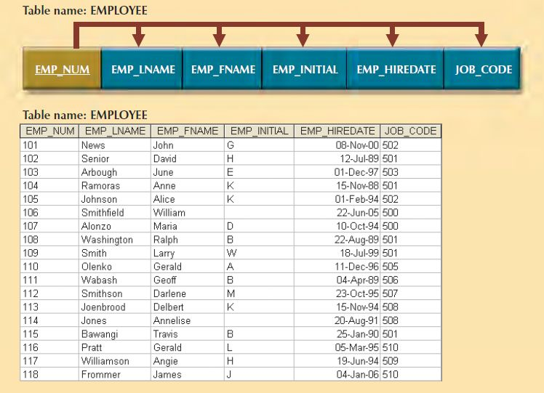

Slide 151
Higher Level Normal Forms
Tables in 3NF will perform suitably in business transactional databases.
However, there are occasions when higher normal forms are useful
special case of 3NF, known as Boyce-Codd normal form(BCNF)
fourth normal form (4NF)

Slide 152
Boyce-Codd normal form (BCNF)
when every determinant in table is candidate key
when table contains only one candidate key, the 3NF and the BCNF are equivalent

Slide 153
Boyce-Codd normal form (BCNF)
table is in 3NF when it is in 2NF and there are no transitive dependencies
nonkey attribute is determinant of key attribute
condition does not violate 3NF, yet it fails to meet the BCNF requirements because BCNF requires that every determinant in the table be candidate key

Slide 154
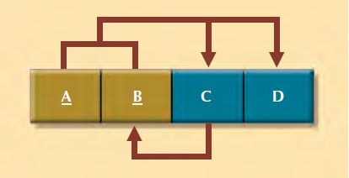
table that is in 3NF but not in BCNF

Slide 155
functional dependencies
A + B → C, D
A + C → B, D
C → B
two candidate keys: (A + B) and (A + C)
has no partial dependencies, nor does it contain transitive dependencies
C → B indicates that nonkey attribute determines part of the PK and that dependency is not transitive or partial because dependent is prime attribute

Slide 156
convert into BCNF
change the primary key to A + C
appropriate action because dependency C → B means that C is, in effect, superset of B
at this point, table is in 1NF because it contains partial dependency, C → B
next, follow standard decomposition procedures to produce results

Slide 157
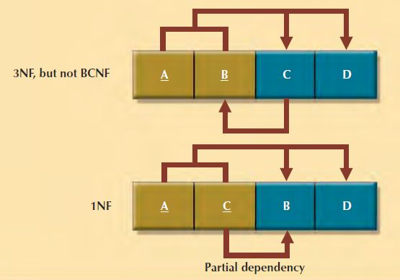
Decomposition to BCNF

Slide 158
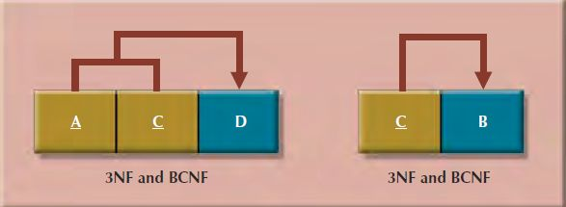
Decomposition to BCNF

Slide 159
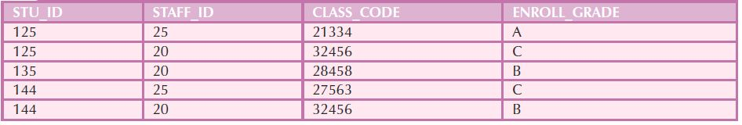
Sample Data for a BCNF Conversion

Slide 160
each CLASS_CODE identifies class uniquely, course might generate many classes
  for example, course labeled INFS 420 might be taught in two classes (sections), each identified by unique code to facilitate registration
  CLASS_CODE 32456 might identify INFS 420, class section 1
  CLASS_CODE 32457 might identify INFS 420, class section 2
  CLASS_CODE 28458 might identify QM 362, class section 5
student can take many classes
staff member can teach many classes, but each class is taught by only one staff member

Slide 161
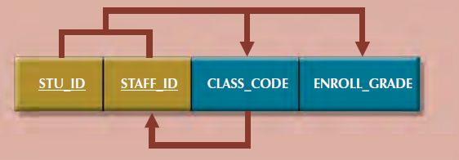

Slide 162
STU_ID + STAFF_ID → CLASS_CODE, ENROLL_GRADE
CLASS_CODE → STAFF_ID

Slide 163
table represented by this structure has major problem, because it is trying to describe two things: staff assignments to classes and student enrollment information
dual-purpose table structure will cause anomalies
if different staff member is assigned to teach class 32456, two rows will require updates, thus producing an update anomaly
if student 135 drops class 28458, information about who taught that class is lost, thus producing a deletion anomaly

Slide 164
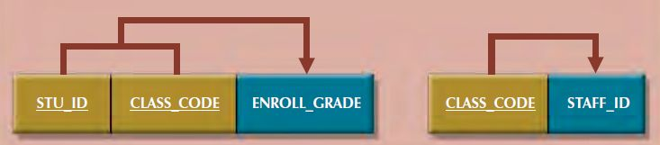

Slide 165
forth normal form (4NF)
multivalued attributes exist
Consider possibility that an employee can have multiple assignments and can also be involved in multiple service organizations
Suppose employee 10123 does volunteer work for Red Cross and United Way; same employee might be assigned to work on three projects: 1, 3, and 4

Slide 166
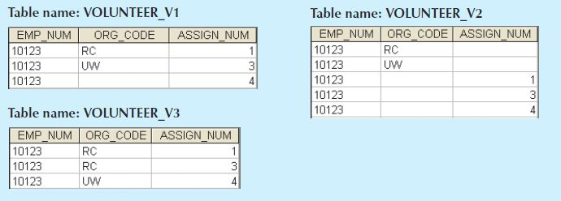

Slide 167
attributes ORG_CODE and ASSIGN_NUM each may have many different values
situation is referred to as multivalued dependency
one key determines multiple values of two other attributes and those attributes are independent of each other
one employee can have many service entries and many assignment entries
one EMP_NUM can determine multiple values of ORG_CODE and multiple values of ASSIGN_NUM
ORG_CODE and ASSIGN_NUM are independent

Slide 168
if versions 1 and 2 are implemented, tables are likely to contain quite a few null values; do not even have a viable candidate keyv
version 3 at least has a PK, but it is composed of all of attributes in the table; meets 3NF requirements, yet it contains many redundancies that are clearly undesirable

Slide 169
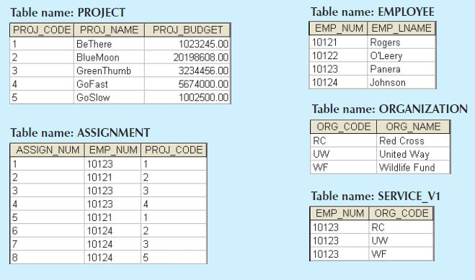
set of tables in 4NF

Slide 170
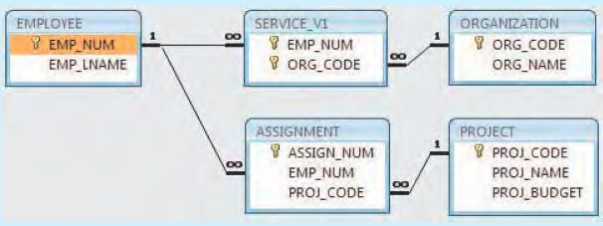
relational diagram

Slide 171
fourth normal form (4NF)
table is in fourth normal form (4NF) when it is in 3NF and has no multivalued dependencies
Normalization should be part of the design process

Slide 172
Data-Modeling Checklist

Slide 173
Business rules
Properly document and verify all business rules with the end users.
Ensure that all business rules are written precisely, clearly, and simply. The business rules must help identify entities, attributes, relationships, and constraints.
Identify the source of all business rules, and ensure that each business rule is justified, dated, and signed off by an approving authority.

Slide 174
Naming Conventions
All names should be limited in length (database-dependent size).
Entity Names:
  Should be nouns that are familiar to business and should be short and meaningful
  Should document abbreviations, synonyms, and aliases for each entity
  Should be unique within the model
  For composite entities, may include a combination of abbreviated names of the entities linked through the composite entity

Slide 175
Naming Conventions
Attribute Names:
  Should be unique within the entity
  Should use the entity abbreviation as a prefix
  Should be descriptive of the characteristic
  Should use suffixes such as _ID, _NUM, or _CODE for the PK attribute
  Should not be a reserved word
  Should not contain spaces or special characters such as @, !, or &

Slide 176
Naming Conventions
Relationship Names:
  Should be active or passive verbs that clearly indicate the nature of the relationship

Slide 177
Entities
Each entity should represent a single subject.
Each entity should represent a set of distinguishable entity instances.
All entities should be in 3NF or higher. Any entities below 3NF should be justified.
The granularity of the entity instance should be clearly defined.
The PK should be clearly defined and support the selected data granularity.

Slide 178
Attributes
Should be simple and single-valued (atomic data)
Should document default values, constraints, synonyms, and aliases
Derived attributes should be clearly identified and include source(s)
Should not be redundant unless this is required for transaction accuracy, performance, or maintaining a history
Nonkey attributes must be fully dependent on the PK attribute

Slide 179
Relationships
Should clearly identify relationship participants
Should clearly define participation, connectivity, and document cardinality

Slide 180
ER Model
Should be validated against expected processes: inserts, updates, and deletes
Should evaluate where, when, and how to maintain a history
Should not contain redundant relationships except as required (see attributes)
Should minimize data redundancy to ensure single-place updates
Should conform to the minimal data rule: “All that is needed is there, and all that is there is needed.”

Slide 181
DataBase
Database Design

Slide 182
Information System
Databases are a part of a larger picture called an information system
database designers must recognize that database is a critical means to an end rather than an end in itself
  managers want the database to serve their management needs
  many databases seem to require that managers alter their routines to fit database requirements

Slide 183
Systems Development Life Cycle (SDLC)
creation and evolution of information systems follows an iterative pattern called the Systems Development Life Cycle (SDLC)
continuous process of creation, maintenance, enhancement, and replacement of the information system
similar cycle applies to databases

Slide 184
Information System
facilitates the transformation of data into information
it allows for management of both data and information
composed of people, hardware, software, database(s), application programs, and procedures
Systems analysis
  process that establishes need for and extent of an information system
Systems development
  process of creating an information system
Purpose

Slide 185
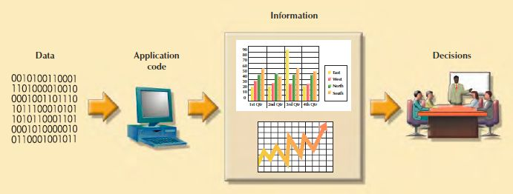
Generating information for decision making

Slide 186
Performance of information system
Database design and implementation
Application design and implementation
Administrative procedures

Slide 187
Systems Development Life Cycle
general framework through which you can track and understand activities required to develop and maintain information systems
there are alternative methodologies, such as:
Unified Modeling Language (UML)
Rapid Application Development (RAD)
Agile Software Development

Slide 188
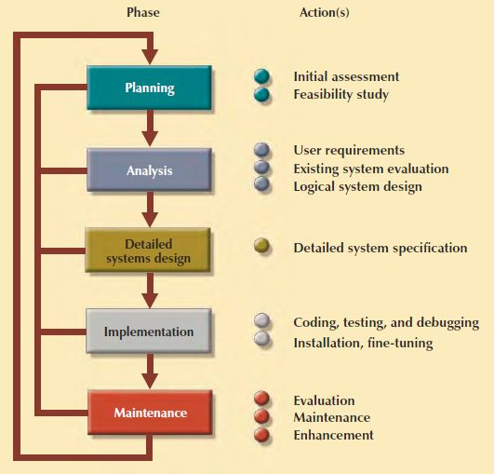
Systems Development Life Cycle

Slide 189
Systems Development Life Cycle
traces the history (life cycle) of an information system
traditional is divided into five phases
  planning, analysis, detailed systems design, implementation, and maintenance
iterative process, rather than sequential

Slide 190
Planning
yields a general overview of objectives
Should the existing system be continued?
Should the existing system be modified?
Should the existing system be replaced?

Slide 191
Feasibility study
technical aspects of hardware and software requirements
system cost
operational cost
  human, technical, and financial resources to keep system operational

Slide 192
Analysis
problems defined during planning phase are examined in greater detail of both individual needs and organizational needs
What are the requirements of the current system’s end users?
Do those requirements fit into the overall information requirements?
Is a thorough audit of user requirements

Slide 193
Detailed Systems Design
completes the design of the system’s processes
includes all necessary technical specifications for screens, menus, reports, and other
steps are laid out for conversion from the old to the new system
training principles and methodologies are also planned and must be submitted for management’s approval

Slide 194
Implementation
hardware, software, DBMS and application programs are installed
database design is implemented
system enters into cycle of coding, testing, and debugging until it is ready to be delivered
database contents loaded
  customized user programs
  database interface programs.
  conversion programs
system is subjected to exhaustive testing until it is ready for use
final documentation is reviewed and printed
end users are trained
system is in full operation
will be continuously evaluated and fine-tuned

Slide 195
Maintenance
almost as soon as system is operational, end users begin to request changes
corrective maintenance in response to systems errors
adaptive maintenance due to changes in the business environment
perfective maintenance to enhance the system

Slide 196
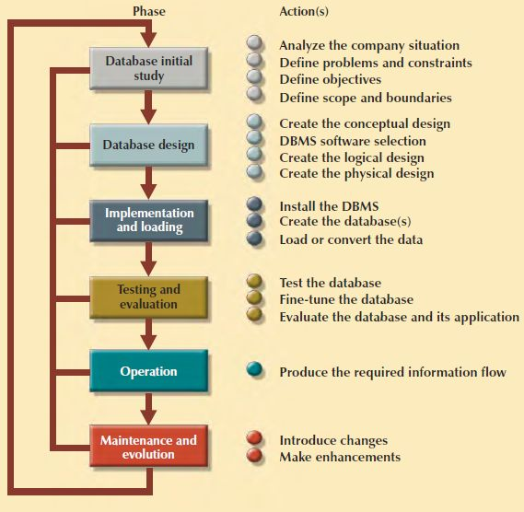
Database Life Cycle

Slide 197
Database Life Cycle
within larger information system, database is subject to a life cycle
contains six phases:
  database initial study, database design, implementation and loading, testing and evaluation, operation, and maintenance and evolution

Slide 198
Database Initial Study
examine current system’s operation
  determine how and why current system fails
database design is a technical business,
it is also people-oriented
overall purpose of database initial study is to:
  analyze company situation
  define problems and constraints
  define objectives
  define scope and boundaries

Slide 199
Database Design
arguably the most critical DBLC phase
  making sure that final product meets user and system requirements
business view of data as a source of information
designer’s view of data structure, its access, and activities required to transform data into information

Slide 200
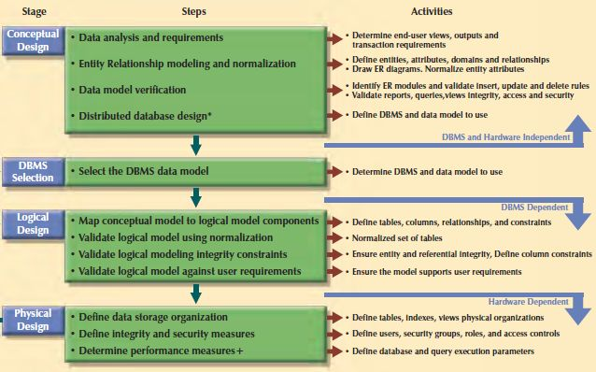
Database design process

Slide 201
Implementation and Loading
output of database design phase is a series of instructions detailing creation of tables, attributes, domains, views, indexes, security constraints, and storage and performance guidelines
actually implement all these design specifications
install DBMS
create database(s)
load or convert data
  typically, data migrated from prior version of system

Slide 202
Testing and Evaluation
occurs in conjunction with applications programming
ensure integrity, security, performance, and recoverability of the database
evaluate the database and its application programs

Slide 203
Testing and Evaluation
physical security allows only authorized personnel physical access to specific areas
password security allows assignment of access rights to specific authorized users
access rights can be established through the use of database software
  restrict operations (CREATE, UPDATE, DELETE, and so on) on predetermined objects such as databases, tables, views, queries, and reports
audit trails are usually provided by DBMS to check for access violations
data encryption can be used to render data useless to unauthorized users who might have violated some of database security layers

Slide 204
Fine-Tune database
different systems will place different performance requirements on database
database performance tuning and query optimization

Slide 205
Common sources of database failure
Software
  traceable to operating system, DBMS software, application programs, or viruses
Hardware
  may include memory chip errors, disk crashes, bad disk sectors, and “disk full” errors
Programming exemptions
  application programs or end users may roll back transactions when certain conditions are defined
  caused by malicious or improperly tested code

Slide 206
Common sources of database failure
Transactions
  system detects deadlocks and aborts one of transactions
External factors
  backups are especially important when a system suffers complete destruction from natural disaster

Slide 207
Operation
database passed evaluation stage, it is considered to be operational
database, management, users, application programs constitute a complete information system

Slide 208
Maintenance and Evolution
DBA perform routine maintenance activities
preventive maintenance (backup)
corrective maintenance (recovery)
adaptive maintenance
  enhancing performance, add entities and attributes …
assignment of access permissions for new and old users
generation of database access statistics to improve efficiency of system audits , to monitor system performance
periodic security audits, system-usage summaries for internal billing or budgeting purposes

Slide 209
Database design process

Slide 210
Conceptual design
design database that is independent of database software and physical details
output of this process is a conceptual data model that describes the main data entities, attributes, relationships, and constraints of a given problem domain - descriptive and narrative in form
generally composed of a graphical representation
textual descriptions of main data elements, relationships, and constraints

Slide 211
Conceptual design
Data analysis and requirements
Entity relationship modeling and normalization
Data model verification
Distributed database design

Slide 212
Data analysis and requirements
information needs
information users
information sources
information constitution
  data elements needed to produce information

Slide 213
Entity relationship modeling and normalization
identify, analyze, and refine business rules
identify main entities
define relationships among entities
define attributes, primary keys, and foreign keys for each of the entities
normalize the entities
complete initial ER diagram
validate ER model against end users’ information and processing requirements
modify ER model

Slide 214
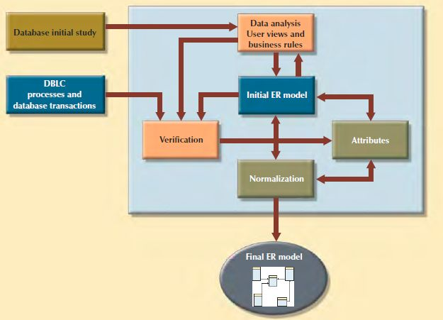
iterative process based on many activities

Slide 215
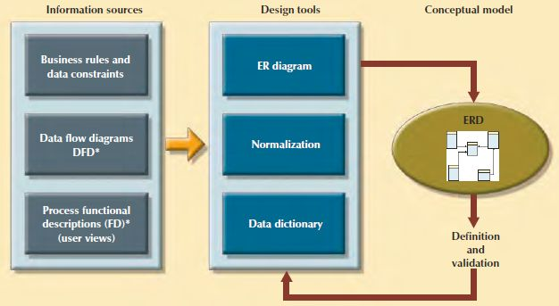
information sources

Slide 216
Data model verification
identify the ER model’s central entity.
identify each module and its components.
identify each module’s transaction requirements:
  Internal: Updates/Inserts/Deletes/Queries/Reports
  External: Module interfaces
verify all processes against system requirements
make all necessary changes suggested
repeat Steps 2−5 for all modules

Slide 217
Distributed database design
although not a requirement for most databases
sometimes database may need to be distributed among multiple geographically disperse locations
  processes that access database may also vary from one location to another
if database data and processes are to be distributed across system, portions of a database, known as database fragments, may reside in several physical locations
database fragment
  subset of database that is stored at given location
  composed of subset of rows or columns from one or multiple tables

Slide 218
DBMS Software Selection
Common factors affecting purchasing decision:
  cost
  DBMS features and tools
  underlying model
  Portability
  DBMS hardware requirements

Slide 219
Logical design
requires that all objects in conceptual model be mapped to specific constructs used by selected database model
includes specifications for relations (tables), relationships, and constraints (i.e., domain definitions, data validations, and security views)

Slide 220
Logical design
map conceptual model to logical model components
validate logical model using normalization
validate logical model integrity constraints
validate logical model against user requirements

Slide 221
Mapping conceptual model to relational model
map strong entities
map supertype/subtype relationships
map weak entities
map binary relationships
map higher degree relationships

Slide 222
Physical design
process of determining data storage organization and data access characteristics o
storage characteristics are function of types of devices supported by hardware, type of data access methods supported by system, and the DBMS
relational databases are more insulated from physical details than older hierarchical and network models

Slide 223
Database Design Strategies
top-down design
  starts by identifying data sets and then defines data elements for each of those sets
  involves identification of different entity types and definition of each entity’s attributes
bottom-up design
  first identifies data elements (items) and then groups them together in data sets
  first defines attributes, and then groups them to form entities

Slide 224
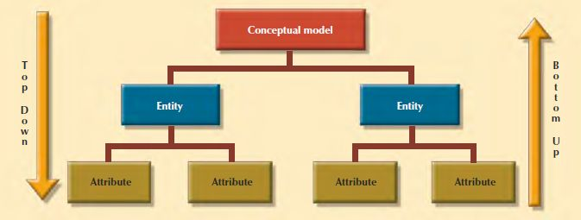
Top-down vs. bottom-up design sequencing

Slide 225
Centralized design
productive when data component is composed of a relatively small number of objects and procedures
can be successfully done by single person or by small, informal design team
operations and scope of problem are sufficiently limited

Slide 226
Decentralized design
might be used when data component of the system has a considerable number of entities and complex relations on which very complex operations are performed
likely to be employed when problem itself is spread across several operational sites and each element is a subset of entire data set

Slide 227
Aggregation problems
synonyms and homonyms
  various departments might know same object by different names (synonyms), or they might use same name to address different objects (homonyms) - object can be entity, attribute, or relationship
entity and entity subtypes
  entity subtype might be viewed as separate entity by one or more departments
  must integrate such subtypes into higher-level entity
conflicting object definitions
  attributes can be recorded as different types (character, numeric), or different domains can be defined for same attribute
  constraint definitions can vary
  must remove such conflicts from model

Slide 228
Problems: connection traps
occur due to misinterpretation of meaning of certain relationships: fan traps and chasm traps
to identify connection traps we must ensure that meaning of relationship is fully understood and clearly defined
if we do not understand relationships we may create model that is not true representation of “real world”

Slide 229
Fan Trap
model represents relationship between entity sets, but pathway between certain entity occurrences is ambiguous
exist where two or more 1:m relationships fan out from same entity

Slide 230
Fan Trap
relationships (1:m) Has and Operates emanating from same entity Division
a single division operates one or more branches and has one or more staff
problem arises when we want to know which members of staff work at particular branch

Slide 231


Example of Fan Trap

Slide 232
Chasm Trap
model suggests existence of relationship between entity sets, but pathway does not exist between certain entity occurrences

Slide 233
Chasm Trap
occur where there are one or more relationships with minimum multiplicity of zero (that is, optional participation) forming part of pathway between related entities

Slide 234
Chasm Trap
potential chasm trap illustrated in relationships between Branch, Staff, and PropertyForRent entities; model represents facts that single branch has one or more staff who oversee zero or more properties for rent; not all staff oversee property and not all properties are overseen
problem arises when we want to know which properties are available at each branch

Slide 235
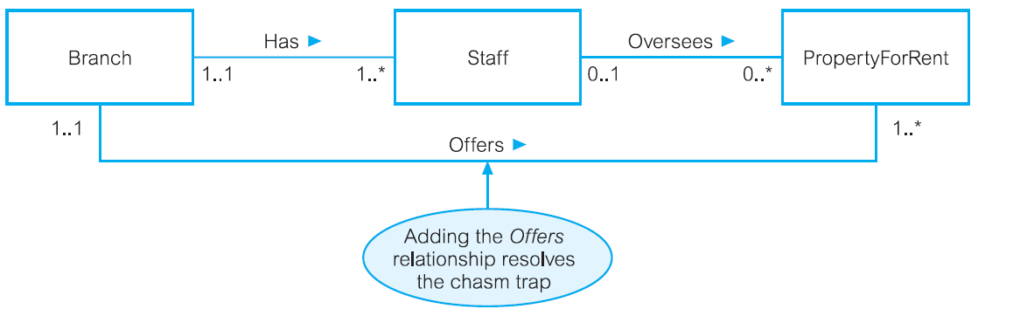
Example of Chasm Trap

Slide 236
Specialization /
Generalization

Slide 237
Specialization/Generalization
associated with special types of entities known as superclasses and subclasses, and process of attribute inheritance
hierarchy of entities containing superclasses and subclasses

Slide 238
Superclass
entity set that includes one or more distinct subgroupings of its occurrences, which must be represented in data model

Slide 239
Subclass
distinct subgrouping of occurrences of entity set, which must be represented in data model

Slide 240
for example
entities that are members of Staff entity set may be classified as Manager, SalesPersonnel, and Secretary
Staff entity is referred to as superclass of
Manager, SalesPersonnel, and Secretary subclasses
superclass/subclass relationship

Slide 241
Superclass/Subclass Relationships
each member of subclass is also member of superclass; but has distinct role
relationship between superclass and subclass is one-to-one (1:1)

Slide 242
Superclass/Subclass Relationships
some superclasses may contain overlapping subclasses (illustrated by member of Staff who is both Manager and Sales Personnel)
not every member of superclass is necessarily member of subclass (members of Staff without distinct job role such as Manager or Sales Personnel)

Slide 243
Possible (but not indicated)
All Up – use superclass without any subclasses
All Down – use many subclasses without superclass
use superclasses and subclasses to avoid describing different types of Staff with possibly different attributes within single entity

Slide 244
avoids describing similar concepts more than once - saving time for designer
adds more semantic information to design in form that is familiar to many
“Manager IS-A member of Staff” - communicates significant semantic content in concise form

Slide 245
for example, Sales Personnel may have special attributes such as salesArea and carAllowance
if all are described by single Staff entity, this may result in a lot of nulls for job-specific attributes

Slide 246
can also show relationships that are associated with only particular types of staff (subclasses) and not with staff, in general;
for example, Sales Personnel may have distinct relationships that are not appropriate for all Staff, such as SalesPersonnel Uses Car

Slide 247
Sales Personnel have common attributes with other Staff, such as staffNo, name, position, and salary

Slide 248
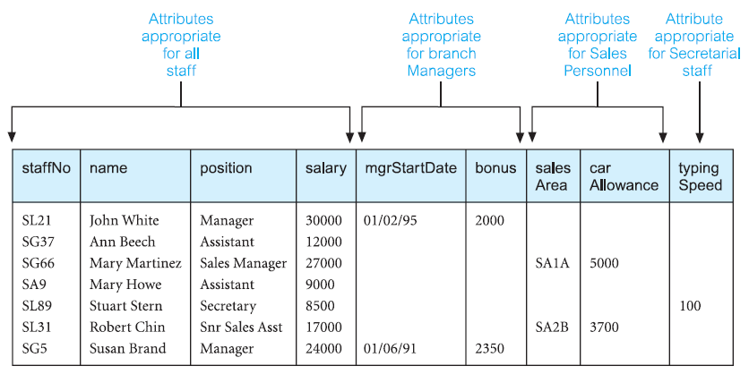
relation AllStaff

Slide 249
Attribute Inheritance
subclass represents same “real world” object as in superclass, may possess subclass-specific attributes, as well as those associated with superclass
SalesPersonnel subclass inherits all attributes of Staff superclass - staffNo, name, position, and salary together with those specifically associated with SalesPersonnel subclass - salesArea and carAllowance

Slide 250
Hierarchy
subclass is an entity in its own right and so it may also have one or more subclasses
Specialization hierarchy (for example, Manager is a specialization of Staff)
Generalization hierarchy (for example, Staff is a generalization of Manager)
IS-A hierarchy (for example, Manager IS-A (member of) Staff)

Slide 251
Specialization process
process of maximizing differences between members of an entity by identifying their distinguishing characteristics
top-down approach to defining set of superclasses and their related subclasses

Slide 252
Generalization process
process of minimizing differences between entities by identifying their common characteristics
bottom-up approach, that results in identification of generalized superclass from original entity types

Slide 253
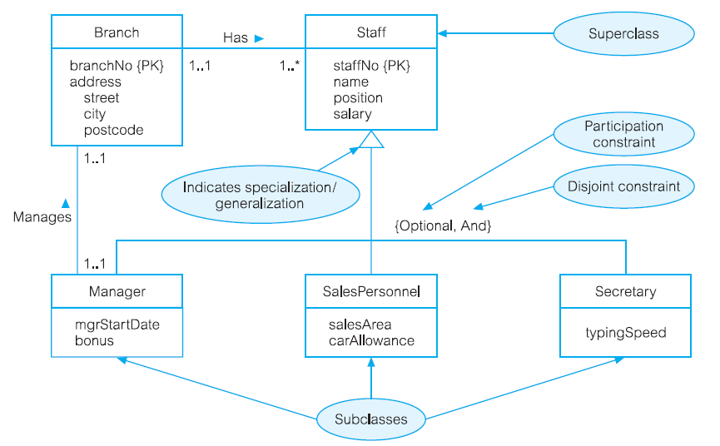
Specialization/generalization of
Staff subclasses representing job roles

Slide 254
may have several specializations of same entity based on different distinguishing characteristics

Slide 255
for example
another specialization of Staff entity may produce subclasses FullTimePermanent and PartTimeTemporary, which distinguishes between types of employment contract for members of staff
attributes that are specific to FullTimePermanent (salaryScale and holidayAllowance) and PartTimeTemporary (hourlyRate)

Slide 256

Staff entity: job roles & contracts of employment

Slide 257
Constraints on Specialization/Generalization
two constraints that may apply to specialization/generalization called participation constraints and disjoint constraints

Slide 258
Participation constraints
determines whether every member in superclass must participate as member of subclass
may be mandatory or optional
mandatory participation specifies that every member in superclass must also be member of a subclass

Slide 259
Disjoint constraints
describes relationship between members of subclasses and indicates whether it is possible for member of superclass to be member of one, or more than one, subclass - applies when superclass has more than one subclass
if subclasses are disjoint, then an entity occurrence can be member of only one of subclasses

Slide 260

specialization hierarchy

Slide 261
case of an aviation business
employs pilots, mechanics, secretaries, accountants, database managers, and many others
pilots share certain characteristics with other employees
  such as last name (EMP_LNAME) and hire date (EMP_HIRE_DATE)
unlike other employees, pilots must meet special requirements such as flight hour restrictions, flight checks, and periodic training
if all employee characteristics and special qualifications were stored in a single EMPLOYEE entity, you would have a lot of nulls

Slide 262
based on hierarchy conclude that PILOT is subtype of EMPLOYEE, and that EMPLOYEE is supertype of PILOT
entity supertype is generic (more general) entity type that is related to one or more specific (specialized) entity subtypes
entity supertype contains common characteristics
entity subtypes contain unique characteristics of each entity subtype
There must be different, identifiable kinds or types of the entity in the user’s environment.
The different kinds or types of instances should have one or more attributes that are unique to that kind or type of instance.

Slide 263
pilots meet both criteria of being an identifiable kind of employee and having unique attributes that other employees do not possess, it is appropriate to create PILOT as a subtype of EMPLOYEE
CLERK would not be an acceptable subtype of EMPLOYEE because it only satisfies one of the criteria—it is an identifiable kind of employee—but there are not any attributes that are unique to just clerks

Slide 264
Specialization Hierarchy
Entity supertypes and subtypes are organized in a specialization hierarchy
specialization hierarchy formed by an EMPLOYEE supertype and three entity subtypes—PILOT, MECHANIC, and ACCOUNTANT
1:1 relationship between EMPLOYEE and its subtypes
  for example PILOT subtype occurrence is related to one instance of the EMPLOYEE

Slide 265
relationships depicted within specialization hierarchy are sometimes described in terms of “is-a” relationships
for example pilot is an employee
subtype can exist only within the context of a supertype
subtype can have only one supertype to which it is directly related
specialization hierarchy can have many levels of supertype/subtype relationships

Slide 266
Inheritance
enables entity subtype to inherit attributes and relationships of supertype
pilots, mechanics, and accountants all inherit employee number, last name, first name, middle initial, hire date, and so on from EMPLOYEE entity
pilots have attributes that are unique; same is true for mechanics and accountants
all entity subtypes inherit their primary key attribute from their supertype
  EMP_NUM attribute is the primary key for each of the subtypes

Slide 267

EMPLOYEE-PILOT supertype-subtype relationship

Slide 268
Subtype Discriminator
attribute in supertype entity that determines to which subtype the supertype occurrence is related
common practice to show subtype discriminator and its value for each subtype in the ER diagram

Slide 269
Disjoint or overlapping entity subtypes
Employee can be a pilot or a mechanic or an accountant
business rules dictates that employee cannot belong to more than one subtype at a time
Disjoint subtypes, also known as non-overlapping subtypes, are subtypes that contain unique subset of the supertype entity set

Slide 270
Overlapping subtypes
if business rule specifies that employees can have multiple classifications, EMPLOYEE supertype may contain overlapping job classification subtypes
contain non-unique subsets of the supertype entity set
for example, in university environment, person may be an employee or student or both

Slide 271

Specialization hierarchy with overlapping subtypes

Slide 272
Completeness constraint
specifies whether each entity supertype occurrence must also be a member of at least one subtype
partial completeness means that not every supertype occurrence is a member of a subtype
  there may be some supertype occurrences that are not members of any subtype
total completeness means that every supertype occurrence must be a member of at least one subtype

Slide 273

Specialization Hierarchy
Constraint Scenarios

Slide 274
Specialization
top-down process of identifying lower-level, more specific entity subtypes from a higher-level entity supertype
based on grouping unique characteristics and relationships of subtypes

Slide 275
Generalization
bottom-up process of identifying higher-level, more generic entity supertype from lower-level entity subtypes
based on grouping common characteristics and relationships of subtypes

Slide 276
Entity Cluster
is a “virtual” entity type used to represent multiple entities and relationships
formed by combining multiple interrelated entities into a single abstract entity object with the purpose of simplifying ER Diagram and thus enhancing its readability

Slide 277
Primary Key
most important characteristic of entity is its primary key
primary key’s function is to guarantee entity integrity
primary keys and foreign keys work together to implement relationships in relational model
primary key has direct bearing on efficiency and effectiveness of database implementation

Slide 278
Natural Key
Natural Key or natural identifier is a real-world, generally accepted identifier used to distinguish — that is, uniquely identify — real-world objects
familiar to end users and forms part of their day-to-day business vocabulary

Slide 279
function of the primary key is to guarantee entity integrity, not to “describe” the entity

Slide 280
primary keys and foreign keys are used to implement relationships among entities
implementation of such relationships is done mostly behind the scenes, hidden from end users
database applications should let end user choose among multiple descriptive narratives of different objects, while using primary key values behind the scenes

Slide 281
Desirable Primary Key Characteristics
Unique values - must uniquely identify each entity instance; it cannot contain nulls
Non-intelligent - should not have embedded semantic meaning other than to uniquely identify each entity instance
attribute with embedded semantic meaning is probably better used as descriptive characteristic of entity than as an identifier
for example, student ID of 650973 would be preferred over Doe, John C. as primary key identifier

Slide 282
Desirable Primary Key Characteristics
No change over time - if attribute has semantic meaning, it might be subject to updates; names do not make good primary keys
  if you have Jane Doe as PK what happens if she changes her name when she gets married?
PK should be permanent and unchangeable
Preferably single-attribute - should have the minimum number of attributes; desirable but not required; simplify implementation of FK; multiple-attribute PK can cause PK of related entities to grow

Slide 283
Desirable Primary Key Characteristics
Preferably numeric - unique values can be better managed when they are numeric, because database can use internal routines to implement automatically increments values with the addition of each new row
Security-compliant - selected primary key must not be composed of any attribute(s) that might be considered security risk or violation
  using Social Security number as PK in EMPLOYEE table is not a good idea

Slide 284
composite primary keys
are particularly useful in two cases:
as identifiers of composite entities, where each primary key combination is allowed only once in the M:N relationship
as identifiers of weak entities, where the weak entity has a strong identifying relationship with the parent entity

Slide 285
surrogate key
instances when primary key doesn’t exist in real world or when existing natural key might not be suitable
standard practice to create surrogate key - primary key created by database designer to simplify identification of entity instances
has no meaning in user’s environment — it exists only to distinguish one entity instance from another
it can be generated by the DBMS to ensure that unique values are always provided

Slide 286
Database Design
Data modeling and database design require skills that are acquired through experience
experience is acquired through practice, regular and frequent repetition, applying the concepts learned to specific and different design problems
presents four special design cases that highlight importance of flexible designs, proper identification of primary keys, and placement of foreign keys

Slide 287
DESIGN CASES
LEARNING FLEXIBLE DATABASE DESIGN
Design Case #1: Implementing 1:1 Relationships
Design Case #2: Maintaining History of Time-Variant Data
Design Case #3: Fan Traps
Design Case #4: Redundant Relationships

Slide 288
Design Case #1:
Implementing 1:1 Relationships
Foreign Keys work with Primary Keys to implement relationships:
  put PK of “one” side (parent entity)
  put FK on “many” side (dependent entity)
case of a 1:1 relationship between EMPLOYEE and DEPARTMENT based on business rule “one EMPLOYEE is the manager of one DEPARTMENT, and one DEPARTMENT is managed by one EMPLOYEE.”

Slide 289
Place FK in both entities - is not recommended, as it would create duplicated work, and it could conflict with other existing relationships
Place FK in one of entities (PK of one of two entities appears as FK in other entity) - preferred solution
  but there is remaining question: which entity should be used

Slide 290
One side is mandatory and other side is optional
  Place PK of entity on mandatory side in entity on optional side as FK, and make FK mandatory
Both sides are optional
  Select FK that causes fewest nulls, or place FK in entity in which the (relationship) role is played
Both sides are mandatory
  Like previous
  or consider revising your model to ensure that the two entities do not belong together in a single entity

Slide 291
As a designer, you must recognize that 1:1 relationships exist in the real world, and therefore, they should be supported in the data model.
In fact, a 1:1 relationship is used to ensure that two entity sets are not placed in the same table.

Slide 292
Design Case #2:
Maintaining History of Time-Variant
Company managers generally realize that good decision making is based on information that is generated through data stored in databases. Such data reflect current as well as past events.
Normally, data changes are managed by replacing existing attribute value with new value
However, there are situations in which history of values for a given attribute must be preserved.
time-variant data refer to data whose values change over time and for which you must keep history of the data changes

Slide 293
some attribute values, such as your date of birth or your Social Security number, are not time variant
attributes such as your student GPA or your bank account balance are subject to change over time
sometimes data changes are externally originated and event driven, such as product price change

Slide 294
keeping history of time-variant data you must create a new entity in 1:M relationship with original entity; this new entity will contain new value, date of change
for example, if you want to keep track of current manager as well as history of all department managers, you can create model

Slide 295


Slide 296
note that “manages” relationship is optional in theory and redundant in practice
at any time, you could find out who manager of department is by retrieving the most recent DATE_ASSIGN date from MGR_HIST
differentiates between current data and historic data
current manager relationship is implemented by “manages” relationship between EMPLOYEE and DEPARTMENT
historic data are managed through EMP_MGR_HIST and DEPT_MGR_HIST

Slide 297
Design Case #3:
Fan Traps
Creating data model requires proper identification of data relationships among entities. However, due to miscommunication or incomplete understanding of business rules or processes, it is not uncommon to misidentify relationships among entities
design trap occurs when relationship is improperly or incompletely identified and is therefore represented in a way that is not consistent with real world
most common design trap is known as fan trap

Slide 298
fan trap occurs when you have one entity in two 1:M relationships to other entities, thus producing an association among the other entities that is not expressed in the model
for example, assume the league has many divisions; each division has many players; each division has many teams
might create

Slide 299

Incorrect ER Diagram with fan trap problem

Slide 300
DIVISION is in 1:M relationship with TEAM and in 1:M relationship with PLAYER
representation is semantically correct, relationships are not properly identified
there is no way to identify which players belong to which team
note that the relationship lines for DIVISION instances fan out to TEAM and PLAYER entity instances — thus “fan trap” label

Slide 301

Corrected ER Diagram after removal of the fan trap

Slide 302
Design Case #4:
Redundant Relationships
Although redundancy is often a good thing to have in computer environments (multiple backups in multiple places, for example), redundancy is seldom a good thing in the database environment
Redundant relationships occur when there are multiple relationship paths between related entities
main concern with redundant relationships is that they remain consistent across the model
some designs use redundant relationships as a way to simplify the design

Slide 303
an example of redundant relationships was introduced during discussion on maintaining a history of time-variant data
use of redundant “manages” and “employs” relationships was justified by the fact that such relationships were dealing with current data rather than historic data

Slide 304

Redundant Relationship

Slide 305
note transitive 1:M relationship between DIVISION and PLAYER through TEAM entity
relationship that connects DIVISION and PLAYER is redundant
relationship could be safely deleted without losing any information-generation capabilities in model

Slide 306
DataBase Design
Examples

Slide 307
Formula 1
https://www.formula1.com/
Races
Drivers
Teams

Slide 308
Driver: Fernando ALONSO
Team McLaren
Country Spain
Podiums 97
Points 1830
Grands Prix entered 272
World Championships 2
Highest race finish 1 (x32)
Highest grid position 1
Date of birth 29/07/1981
Place of birth Oviedo, Spain

Slide 309
Who is famous for using the catchphrase "allons-y Alonso“ ?
Time traveler

Slide 310
Driver: Fernando ALONSO
Team McLaren
Country Spain
Podiums 97
Points 1830
Grands Prix entered 272
World Championships 2
Highest race finish 1 (x32)
Highest grid position 1
Date of birth 29/07/1981
Place of birth Oviedo, Spain

Slide 311
Entities
Affiliation
Result

Slide 312
Affiliation
ID of Fernando ALONSO
ID of McLaren
Begin Date
End Date - could be NULL
  NULL with meaning from Begin Date until today, tomorrow, end of time, …

Slide 313
Affiliation view
as of today()
JOIN FROM Driver, Affiliation, Team
WHERE Begin Date <= today() AND
(today () <= End Date OR End Date IS NULL)

Slide 314
Begin End Date are time intervals
Begin <= End OR End IS NULL
Time interval intersection
(T₁₁, T₁₂), T₁₁ <= T₁₂
(T₂₁, T₂₂), T₂₁ <= T₂₂

Slide 315
Begin End Date are time intervals
Begin <= End OR End IS NULL
Time interval intersection
(T₁₁, T₁₂), T₂₁ <= T₂₂
(T₂₁, T₂₂), T₂₁ <= T₂₂
T₁₁ <= T₂₂ AND T₁₂ >= T₂₁

Slide 316
Temporal Databases
provide uniform and systematic way of dealing with historical data
some data may be inherently historical, e.g., medical or judicial records
regarded as enhancement of conventional (snapshot) database
sets data into context of time, adds a time dimension

Slide 317
over time, relational tables are updated, new rows are inserted, some rows are deleted and some attribute values might be modified - data in table changes over time
if copy of table was taken each time before it is updated and if date of copy was added to all rows we could actually follow evolution of table

Slide 318
in contrast, in many databases, one would only keep current copy of table - current snapshot
time cube snapshot is time slice of such cube, conventional database always holds one slice whereas temporal database holds entire cube

Slide 319
whenever an update occurs conventional database physically updates, throws old values away and stores new ones
temporal database is updated logically, it marks old and new values with timestamps that indicate to which snapshot actually belong
concept of physical vs. logical deletion

Slide 320
Set … Picture
UPDATE AutoDriver
  SET Picture =
(SELECT BulkColumn FROM OPENROWSET (Bulk 'D:\Downloads\1458061391663.jpg', SINGLE_BLOB) AS BLOB)
WHERE id_ad = 1;

Slide 321
Executed Only Once in DataBase Server
USE master
    GO
EXEC sp_configure 'show advanced options', 1
    GO
RECONFIGURE WITH OVERRIDE
    GO
EXEC sp_configure 'xp_cmdshell', 1
    GO
RECONFIGURE WITH OVERRIDE
    GO
EXEC sp_configure 'show advanced options', 0
    GO

Slide 322
Get … Picture
EXEC xp_cmdshell
'BCP "SELECT [Picture] FROM [formula1].[dbo].[AutoDriver] WHERE [id_ad] = 1" queryout "D:\Downloads\alonso.jpg" -T -n'
;

Slide 323
Challenge
build a “manele” database with pictures and sound

Slide 324
manele

Slide 325
MS SQL Server - configure
USE master
    GO
EXEC sp_configure 'show advanced options', 1
    GO
RECONFIGURE WITH OVERRIDE
    GO
EXEC sp_configure 'xp_cmdshell', 1
    GO
RECONFIGURE WITH OVERRIDE
    GO
EXEC sp_configure 'show advanced options', 0
    GO

Slide 326
MS SQL Server – Data Type
for binary - VARBINARY(max)

Slide 327
MS SQL Server - SET
UPDATE manea SET manea =
(SELECT BulkColumn FROM OPENROWSET (Bulk 'D:\Downloads\Carmen Serban - Picioarele epilate sunt ca sarea in bucate.mp3', SINGLE_BLOB) AS BLOB)
WHERE id_manea = 1;
UPDATE manea SET manea =
(SELECT BulkColumn FROM OPENROWSET (Bulk 'D:\Downloads\Carmen Serban-Viata bate filmul.mp3', SINGLE_BLOB) AS BLOB)
WHERE id_manea = 2;

Slide 328
MS SQL Server - GET
EXEC xp_cmdshell
'BCP "SELECT [manea] FROM [manele].[dbo].[manea] WHERE [id_manea] = 1" queryout "D:\Downloads\FileOut1.mp3" -T -n'
EXEC xp_cmdshell
'BCP "SELECT [manea] FROM [manele].[dbo].[manea] WHERE [id_manea] = 2" queryout "D:\Downloads\FileOut2.mp3" -T -n'

Slide 329
MySQL - configure
max_allowed_packet=100M
in my.ini

Slide 330
MySQL Server – Data Type
LargeBLOB (Binary Large OBject)

Slide 331
MySQL - SET
UPDATE manea SET manea =
LOAD_FILE(‘D:/Downloads/Carmen Serban - Picioarele epilate sunt ca sarea in bucate.mp3')
WHERE idmanea = 1;
UPDATE manea SET manea =
LOAD_FILE(‘D:/Downloads/Carmen Serban-Viata bate filmul.mp3')
WHERE idmanea = 2;

Slide 332
MySQL - GET
SELECT manea INTO DumpFile ‘D:/Downloads/FileOut1.mp3‘
FROM manea WHERE idmanea = 1;
SELECT manea INTO DumpFile ‘D:/Downloads/FileOut2.mp3‘
FROM manea WHERE idmanea = 2;

Slide 333
Wisdom
Additional optional material

Slide 334
Picioarele Epilate Sunt Ca Sarea in Bucate
Epilate Legs Are Like Salt in Food

Slide 335
Viaţă bate filmul
Mi-am tocit hainele în coate
Să termin o facultate
…
Sunt zilier cu facultate
La un patron fără carte
…
  Să am banii de chirie

Slide 336
Viaţă bate filmul
…
Eu sunt fraierul cu carte
Toţi îmi spun intelectualul
Dar nu am caşcavalul
Ieri eram ingineraşul
De azi să îmi spuneţi naşul
…

